Slide 1
Rummikub
CS / MATH 371-001
Cat Appelman & Lars Hebenstiel

Slide 2
What is Rummikub?

Slide 3
2 - 4 players
Goal: get rid of all tiles on your rack
Players start with 14 random tiles
As in Rummy and Mahjong, there are melds
Melds are runs or sets
Tiles: 4 colors, 1-13, 2 copies of each tile and 2 jokers. Total = 106 tiles
Tiles already on the board can be moved around at will
A fusion of the card game Rummy and 麻将 (Mahjong)

Slide 4
Interface

Slide 5
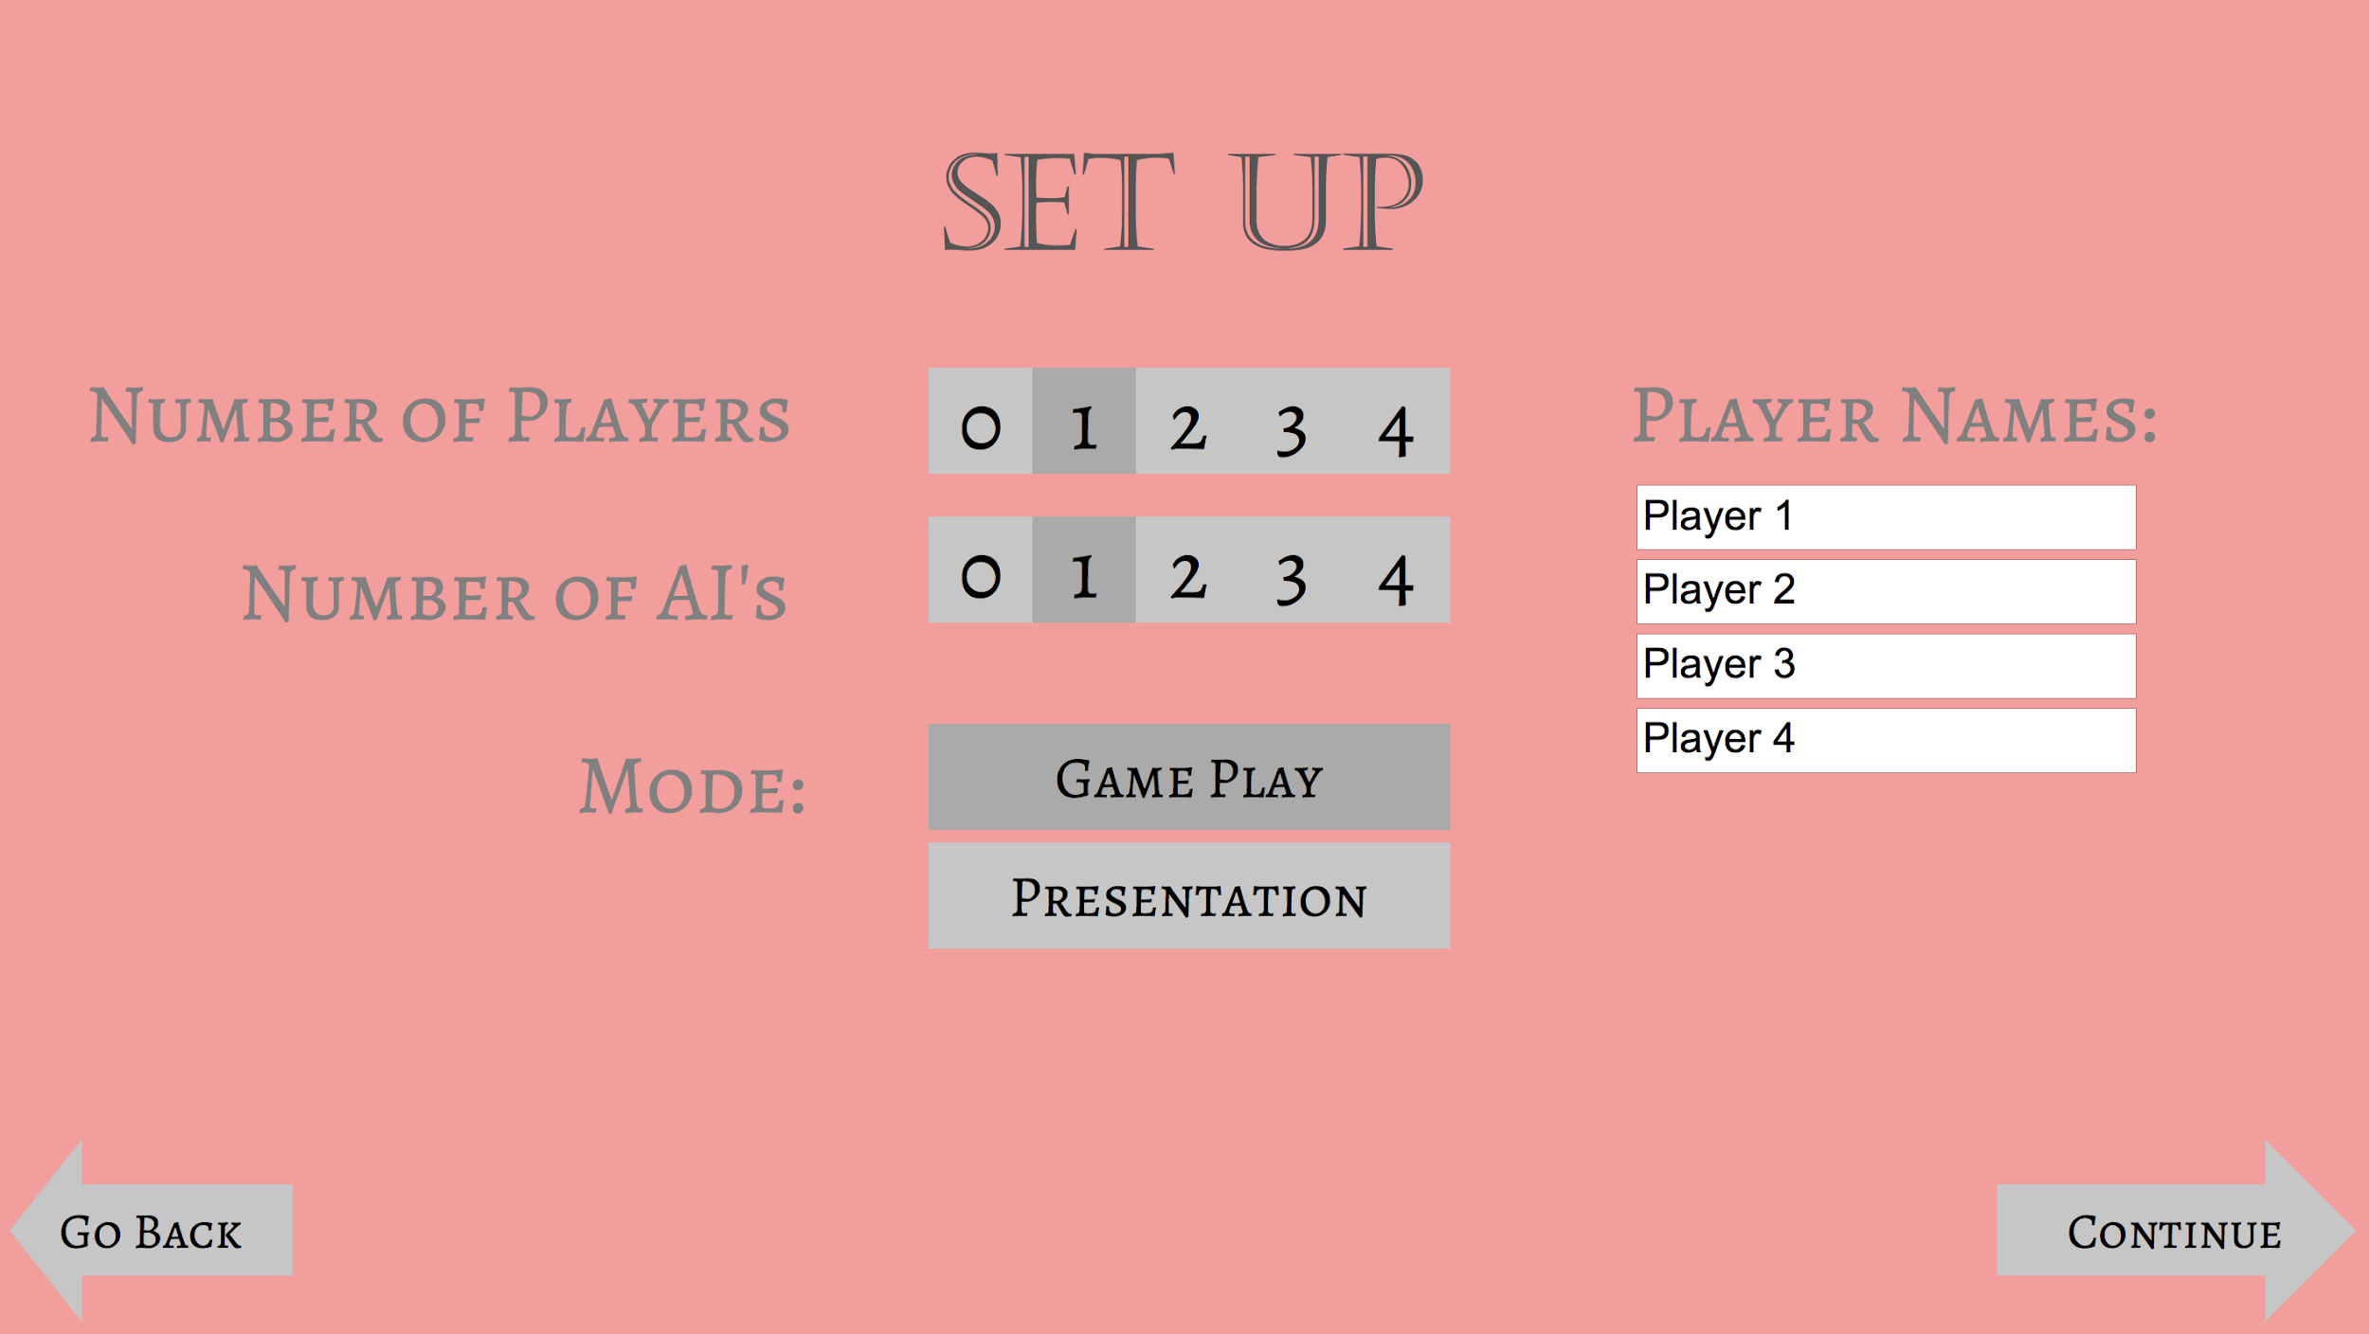
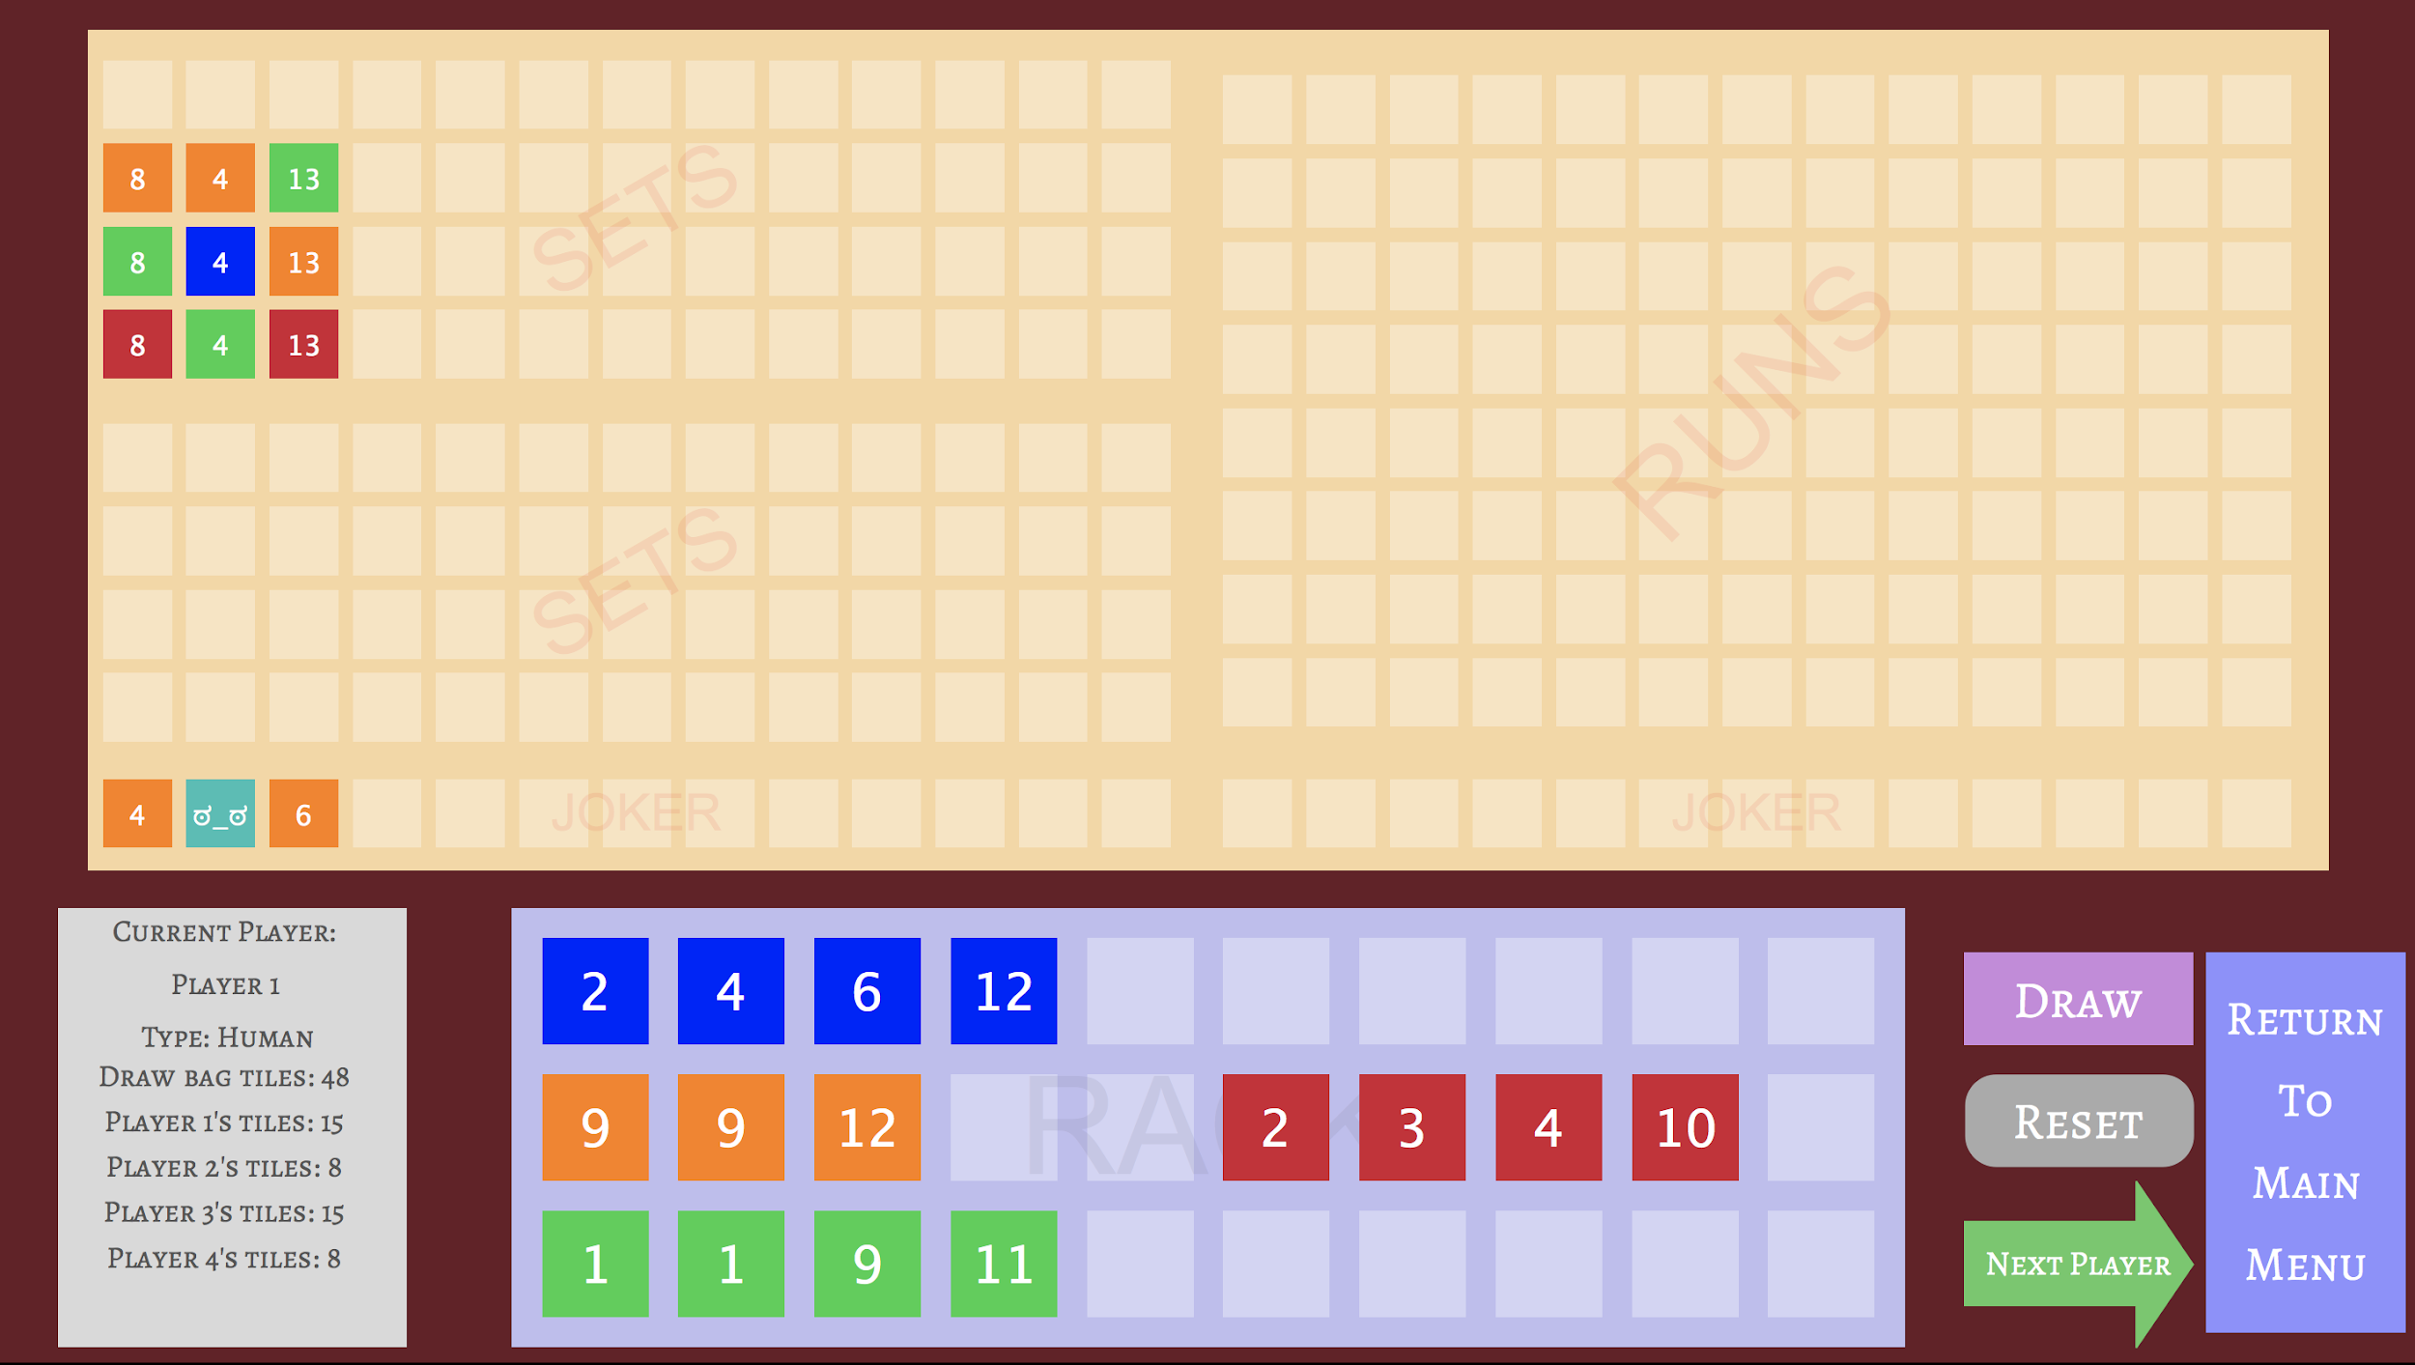
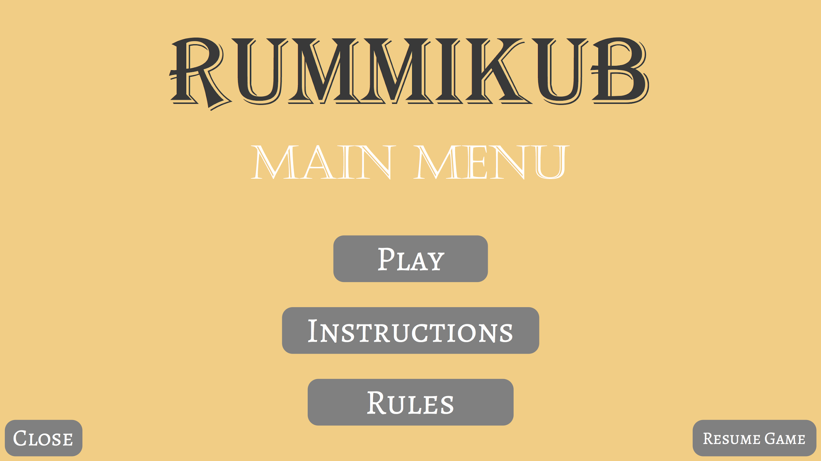
Examples of current graphics

Slide 6
Tutorial!

Slide 7
Buttons and Tiles

Slide 8
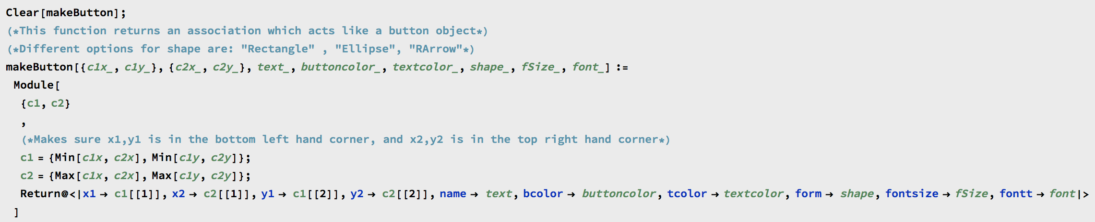
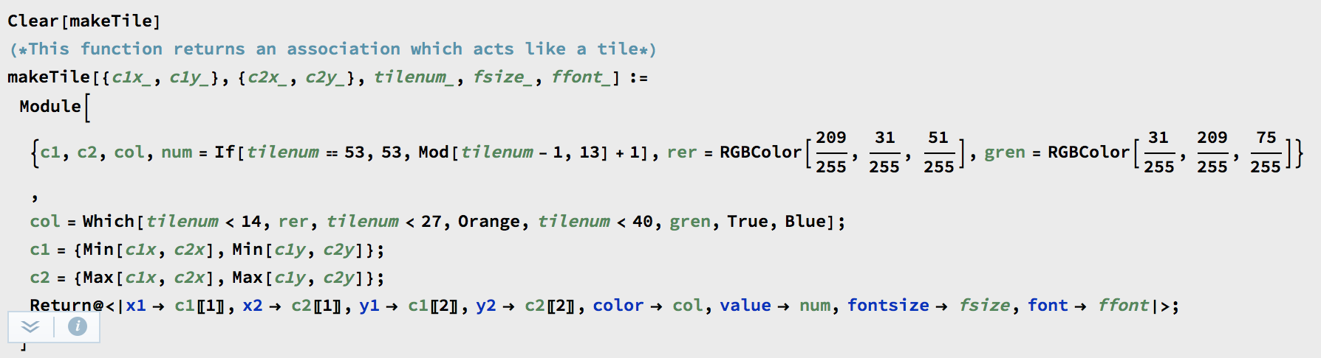
To make our buttons and tiles look nice we took inspiration from java and treated buttons and tiles like objects.
Button Functions
makeButton
setButtonColor
buttonPressed
drawButton
Tile Functions
makeTile
drawTile
drawSelectedTile
moveTile
changeFontSize
tileSelected

Slide 9
Artificial Intelligence

Slide 10
Method One -
Brute Force
# Possibilities = 2^{n}-1
1
2
This method attempted to solve to problem by considering all possible ways to lay down the tiles
Pros:
Guaranteed best solution, easy to implement
Cons:
Really slow
3
4
16366 More
14

Slide 11
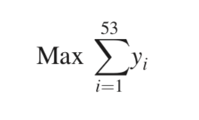
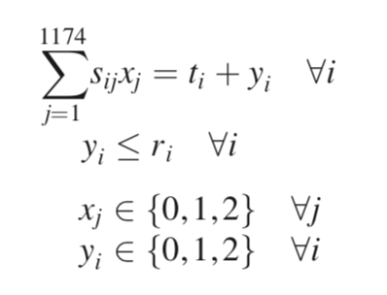
Method Two -
Integer Linear Programming
Objective:
Maximize the amount of pieces laid down
This method attempted to solve the problem by turning it into an ILP problem. (Hertog & Hulshof, 2006)
Pros:
Guaranteed best solution
Cons:
~1400 variables needed, really slow
Constraints:
Can’t lay down pieces you don’t have
All melds have to be valid
Total of pieces on the board must equal the amount already there plus the amount added

Slide 12
Method Three -
Heuristic Tree Search
0
0
1
This method attempted to solve the problem by considering a tree of possible solutions and choosing the best one.
Pros:
Not really slow
Cons:
Does not make perfect moves, still an exponential time algorithm
5
2
4
6
8
9

Slide 13
Algorithms

Slide 14
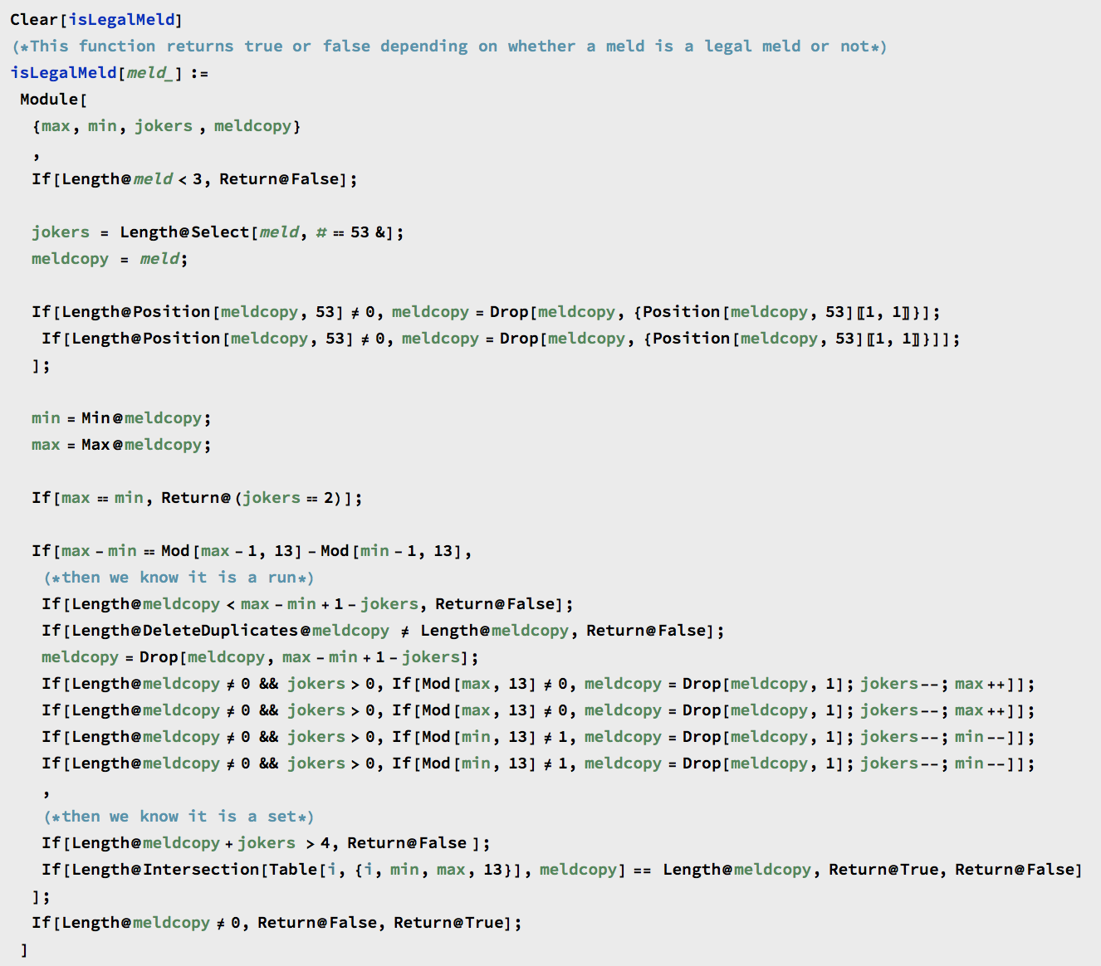
isLegalMeld

Slide 15
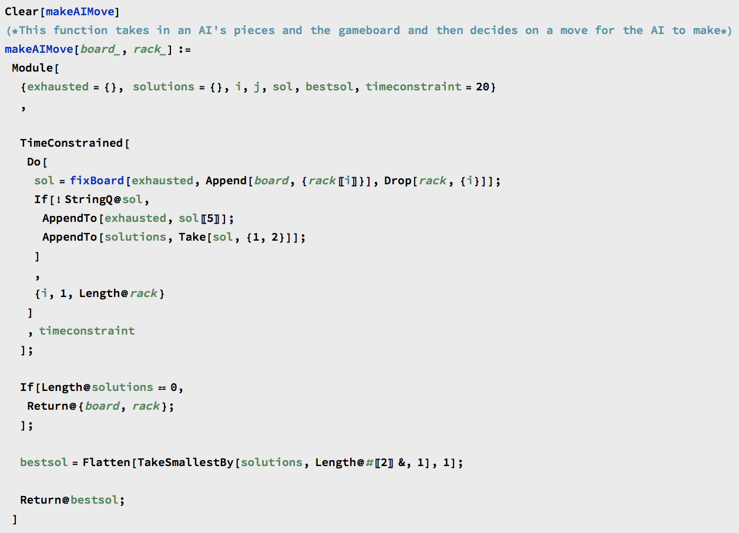
makeAIMove

Slide 16
fixBoard(board, tiles, exhausted) {
//tree is the tree of possible solutions
While (tree has unsearched leaf nodes) {
Bestsol = getBestSol();
If (best solution is legal)
//maximize the tiles laid then return it
Return bestsol
//otherwise find shortest illegal meld
Illmeld = getShortestIllegalMeld();
//append tile from illmeld to other meld
For each tile append it to all other melds
If legal add to tree
//append tiles from other melds to illmeld
For each tile in other melds append it to illmeld
If legal add to tree
//Add tiles from rack
For each tile on rack add it to illmeld
If legal add to tree
}
Return no solution
}
fixBoard
No code for this one, because it is too long. Instead we have pseudocode.

